Slide 1
BAIUST COMPUTER CLUB WEBSITE
TEAM MEMBERS :
Tawsif Rahman Shopnil
Syed Ahmed Mottaqin Dhrubo
Ashadul Amin Fahim

Slide 2
ORGANIZATION
OVERVIEW
BACKGROUND
Pioneer Club of BAIUST Initiated in 2015
Co-curricular activities club.
Main objective is offering opportunities for each affiliate to share their knowledge and grow their skills
Encouraging the development of interests so that the affiliates can make the most favorable use of their computers and computer-related equipment

Slide 3
Location
It’s a co-curricular activities club supervised by Dept. of CSE,BAIUST

Slide 4
FUNCTION
Provides students a platform where they gain knowledge about the Anatomy of the Computer.
Provides students a platform where they can share their knowledge on current trends in Information Technology.
Making students aware of the evolving technologies by organizing Seminars, Workshops, Contests, Bootcamps

Slide 5
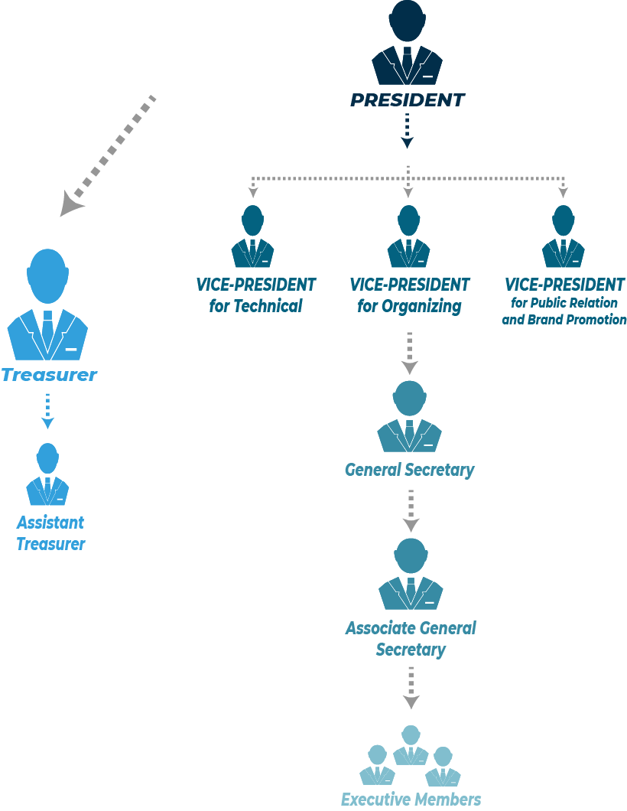
MANAGEMENT HIERARCHY
Advisory Panel
Consists of Faculty Members, Ex-Executive Panel Members
Executive Panel

Slide 6
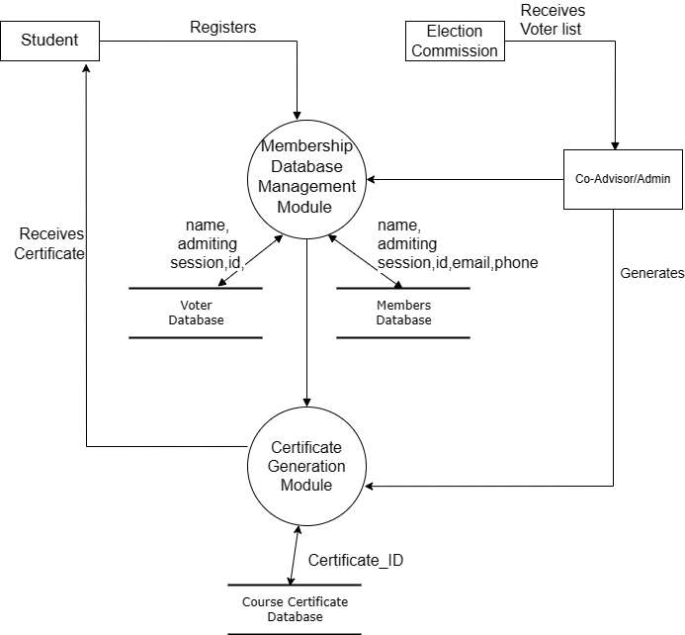
DATA FLOW DIAGRAM
Figure: DFD of BCC Website

Slide 7
PROBLEM
Membership Management
Voter List Generation
Less Outreach

Slide 8
GOAL
Making a Central Membership Database.
Offering Skill based Courses and Certificates Verification Module for certificates given from Computer Club.
Voter List automation System.

Slide 9
ALTERNATIVE SOLUTION
Mobile APP
Offline Digital Management System
Dynamic Landing Page with generic info

Slide 10
Feasebility Analysis
It is technically feasible as a subdomain already exists (bcc.baiust.edu.bd) and it can be easily maintained by a developer.
It is operationally feasible as it has an admin panel and admin can manage it easily.
Economically Feasible as it can generate revenue through advertisement or sponsorship

Slide 11
System Requirement Specification
System Features:
Membership Registration
Automated voter list generation from member Database
Course Certificate generation module
External Interface Requirements
Front-End: HTML, CSS, php
Backend: SQL
Non-Functional Requirements
E-R Diagram for Database

Slide 12
System Requirement Specification
System Features:
Membership Registration
Automated voter list generation from member Database
Course Certificate generation module
External Interface Requirements
Front-End: HTML, CSS, php
Backend: SQL
Non-Functional Requirements
E-R Diagram for Database

Slide 13
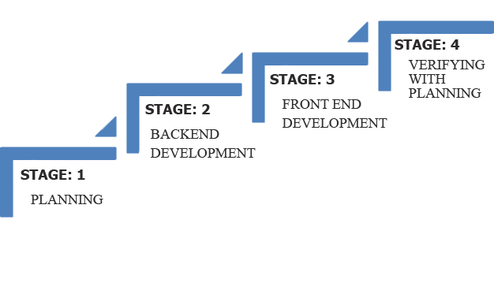
Implementation Overview

Slide 14
Discussion
Through this website we achieve:
Representation of Organization.
Membership Management.
Voter List Generation during Club Election.
Course Certificate Generation Tool.

Slide 15
THANK YOU ALL!

